Slide 1
Service Mesh & Security
For Kubernetes
Version 0.8.5

Slide 2
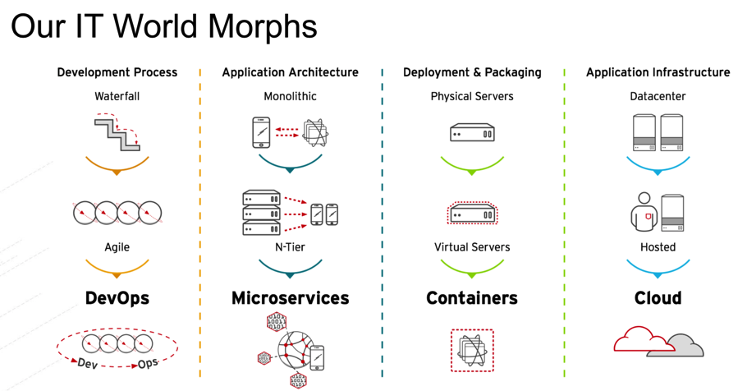
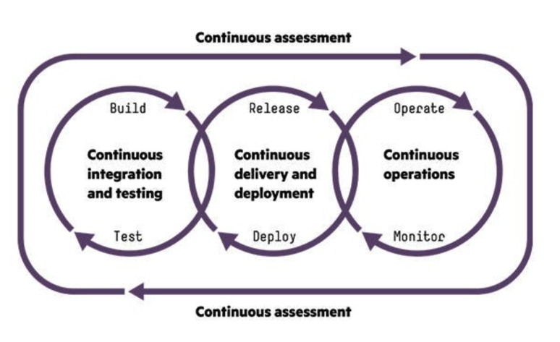
1. Digital Transformation: IT World is changing
https://www.slideshare.net/asotobu/sail-in-the-cloud

Slide 3
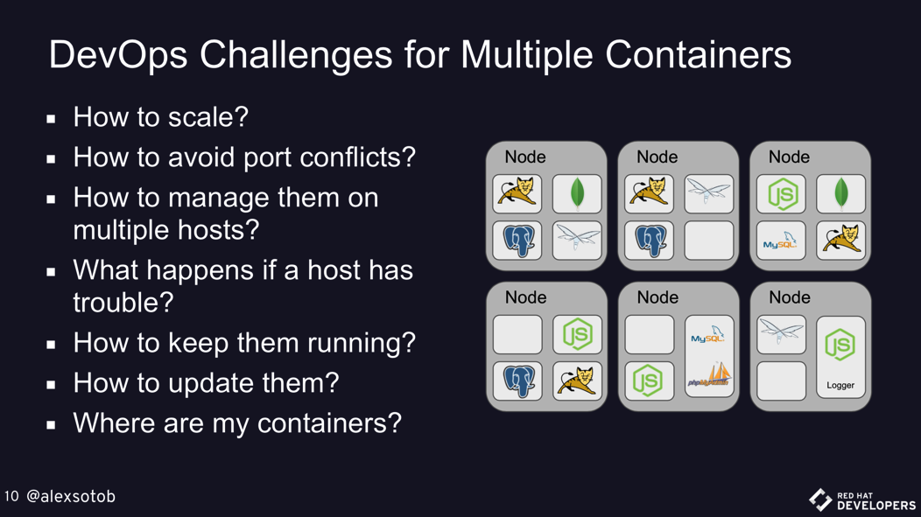
1. Digital Transformation: New challenges
https://www.slideshare.net/asotobu/sail-in-the-cloud

Slide 4
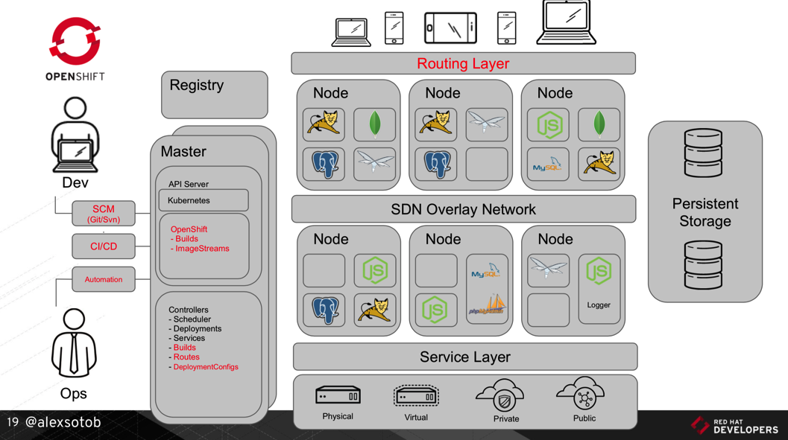
1. Digital Transformation: A new Platform
https://www.slideshare.net/asotobu/sail-in-the-cloud

Slide 5
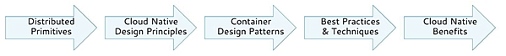
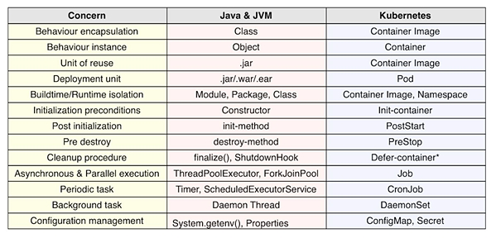
2. Kubernetes effect on the SDLC: Primitives (1/2)
1
https://www.infoq.com/articles/kubernetes-effect

Slide 6
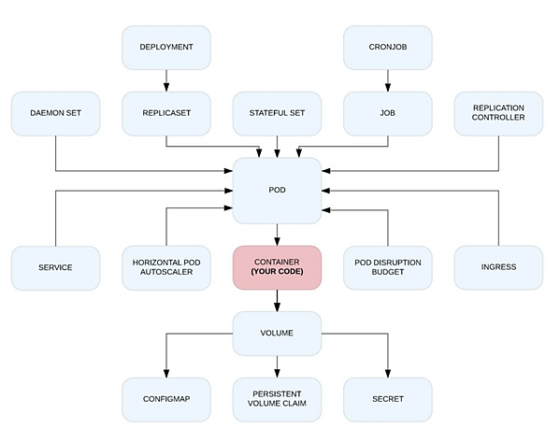
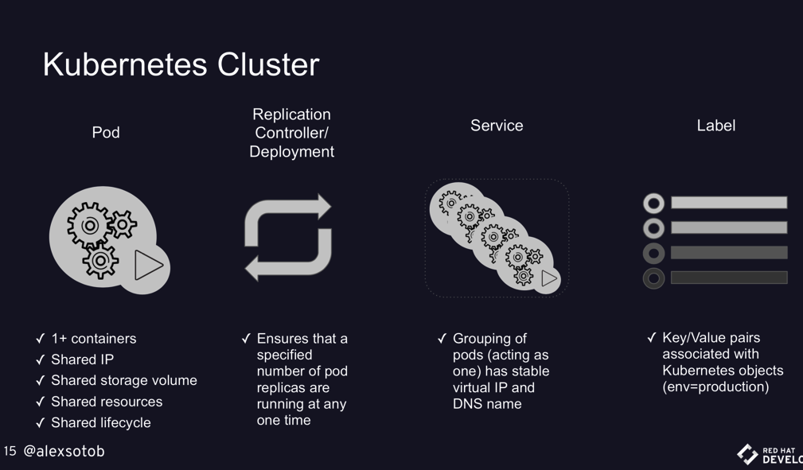
2. Kubernetes effect on the SDLC: Primitives (2/2)
1
https://www.infoq.com/articles/kubernetes-effect
https://www.slideshare.net/asotobu/sail-in-the-cloud

Slide 7
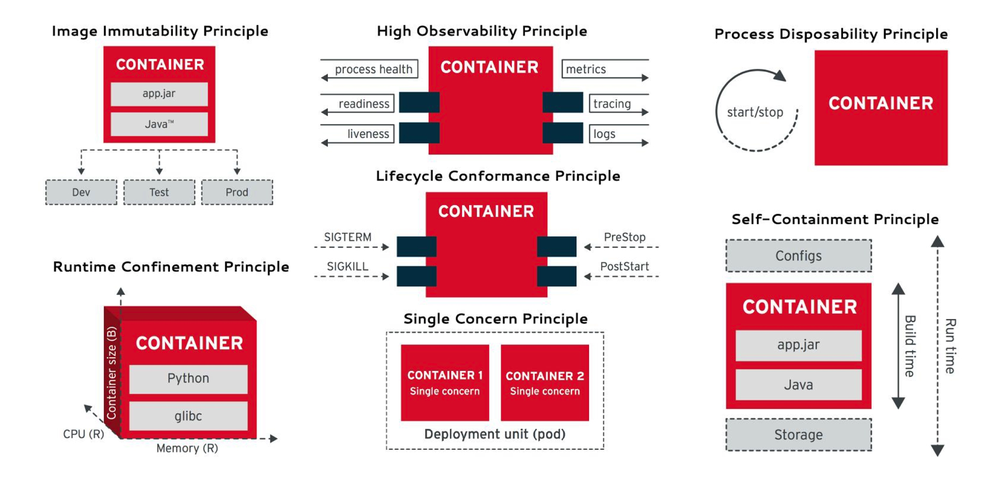
2. Kubernetes effect on the SDLC: Principles
2
https://www.infoq.com/articles/kubernetes-effect

Slide 8
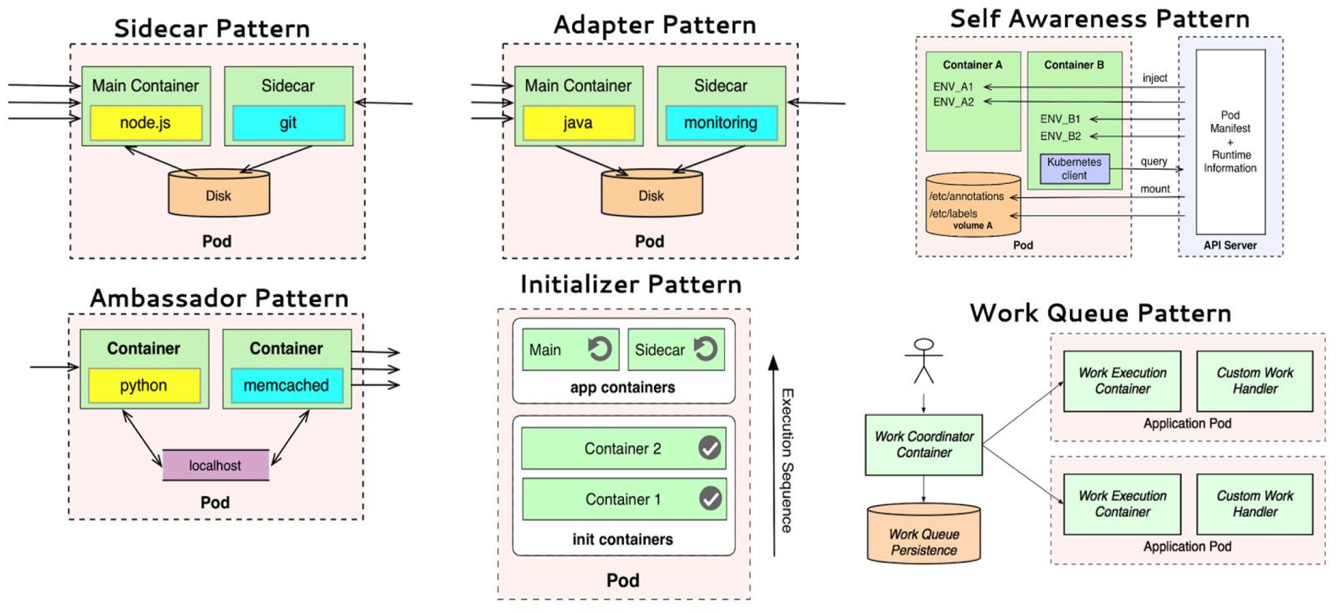
2. Kubernetes effect on the SDLC: Patterns
3
https://www.infoq.com/articles/kubernetes-effect

Slide 9
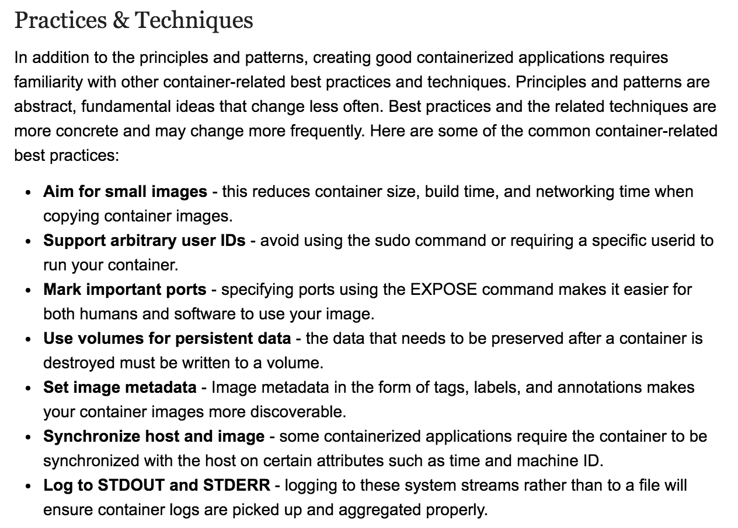
2. Kubernetes effect on the SDLC: Best Practices
4
https://www.infoq.com/articles/kubernetes-effect

Slide 10
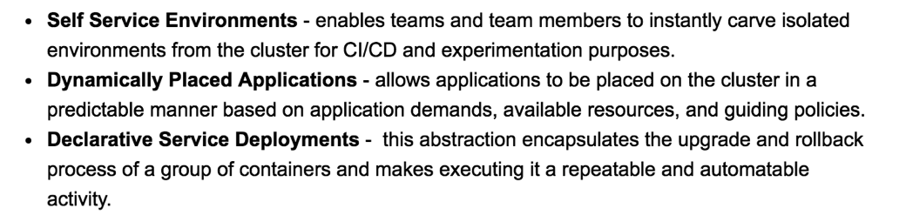
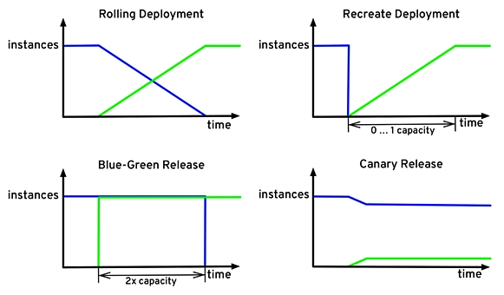
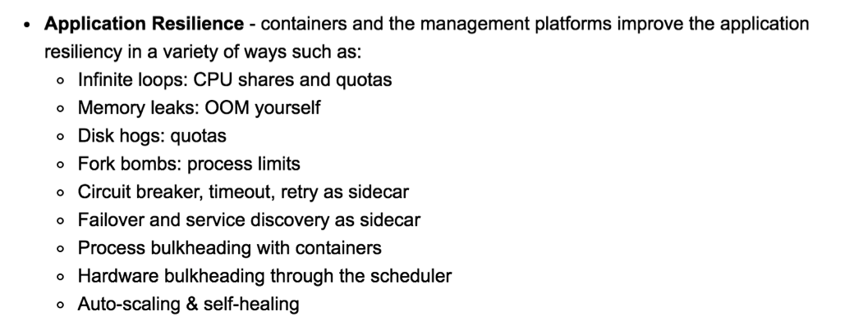
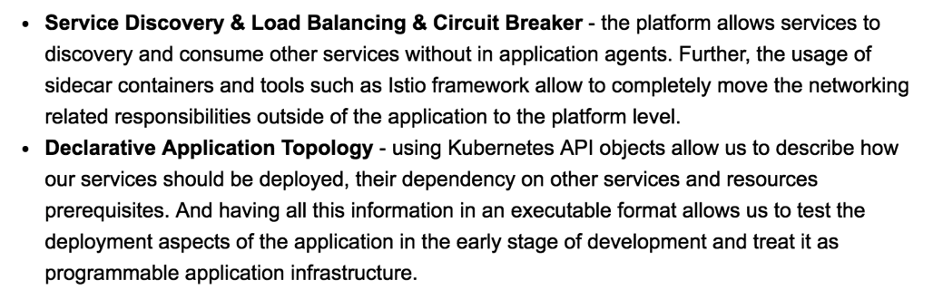
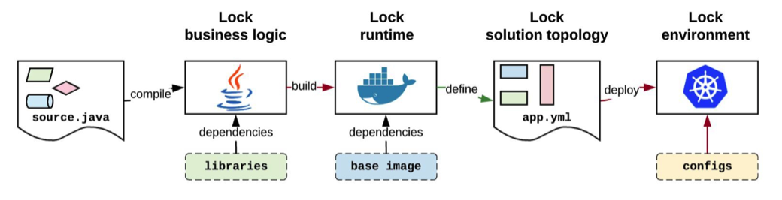
2. Kubernetes effect on the SDLC: Benefits
5
https://www.infoq.com/articles/kubernetes-effect

Slide 11

3. Lab 00: Building K8s - Choose yours (1/2)
Vanilla
Kubernetes Clients
Kubernetes flavours
Self Managed
Full Managed Cloud
kubectl
(kubernetes)
Kubernetes Cluster
On-premise
Google Kubernetes Engine
KVM
VMWare
oc (openshift)
RedHat OpenShift v3
Azure Container Service (AKS)
Amazon EC2
az
(azure)
RedHat OpenShift Container Platform
Minimalist
Minikube
OpenShift
Minishift
Amazon Fargate
Amazon EKS
Amazon ECS
Managed

Slide 12
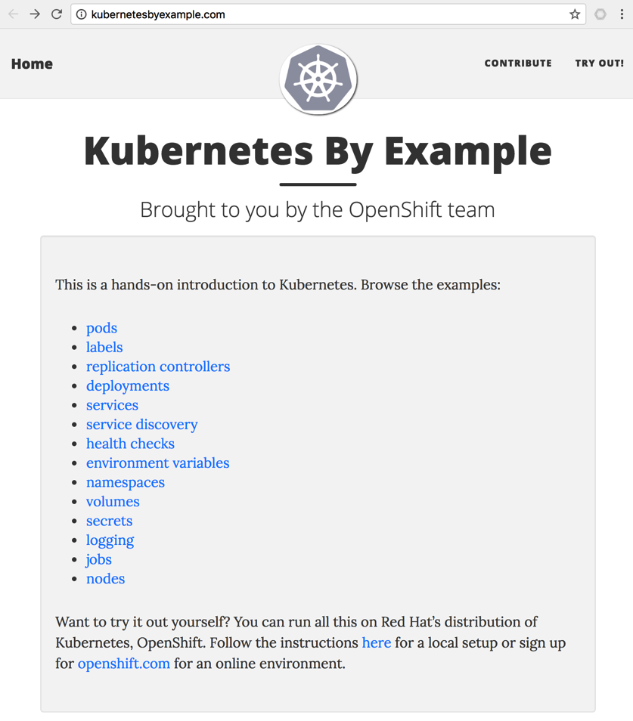
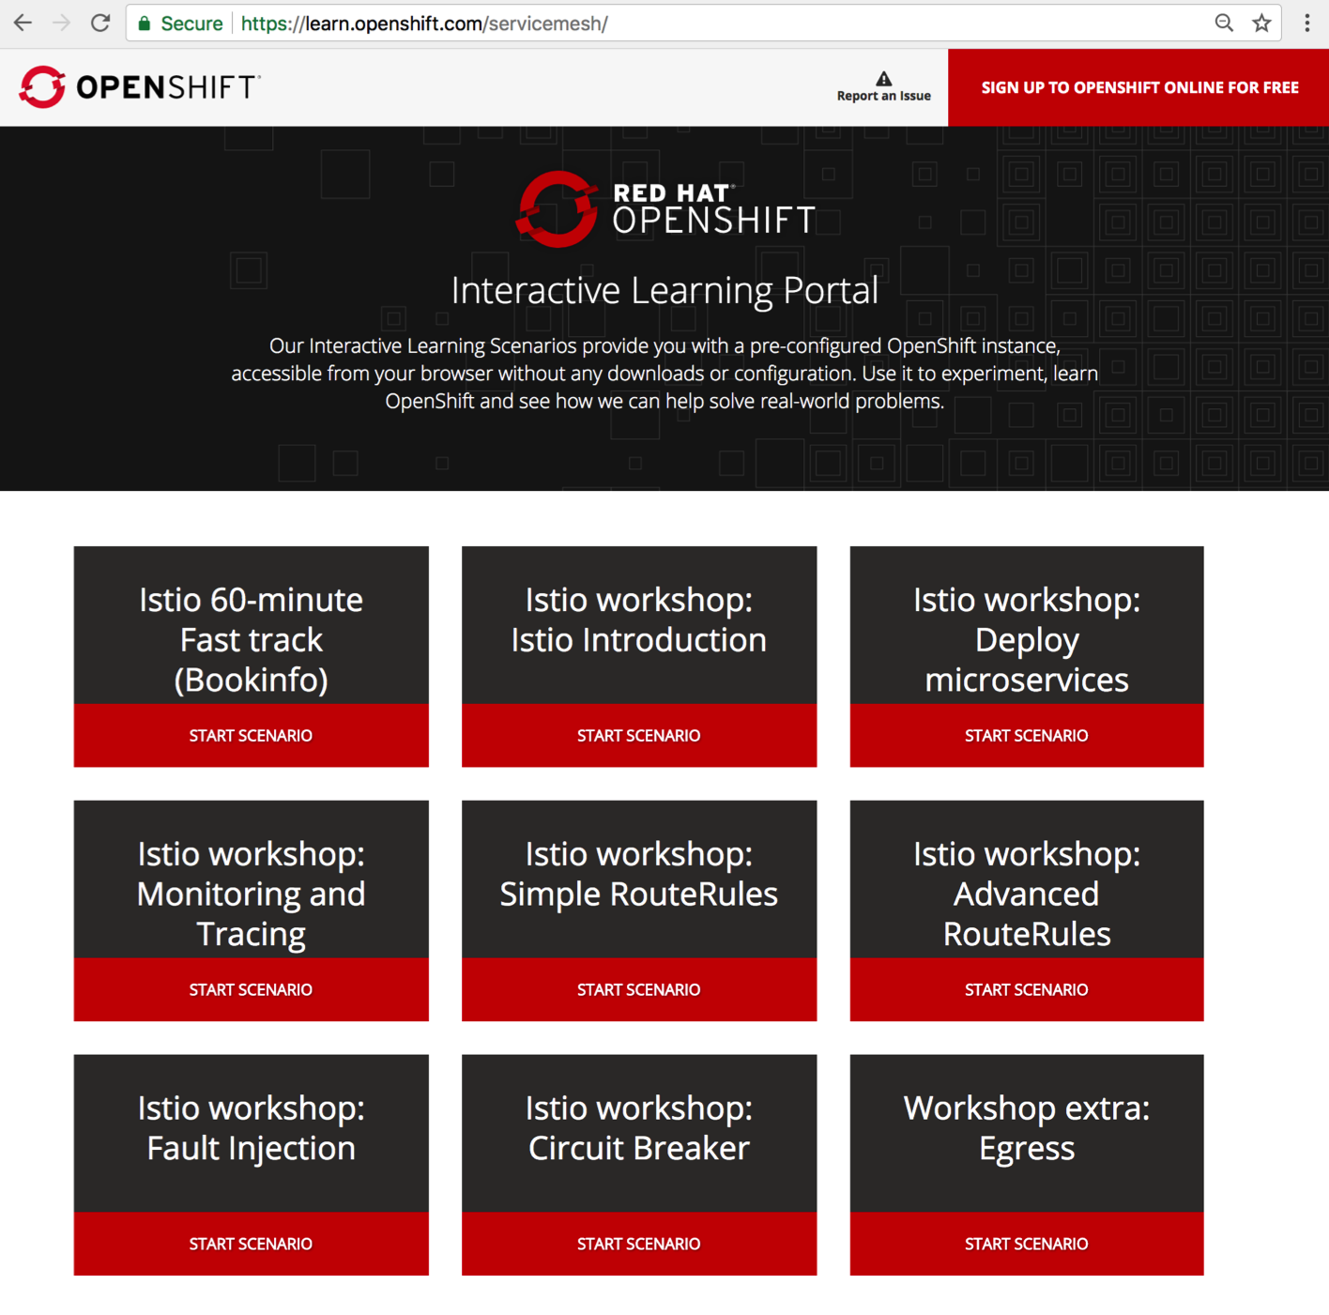
3. Lab 00: Building K8s - Acquire practice (2/2)
1
https://learn.openshift.com/servicemesh/
https://www.katacoda.com/courses/kubernetes
http://kubernetesbyexample.com

Slide 13

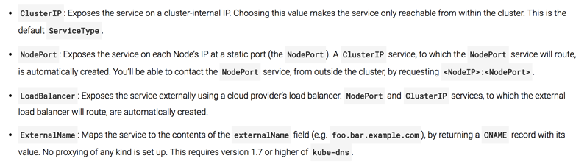
3. Lab 01: Delivering Apps (Pods & Services) (1/3)
Hosting (Amazon EC2, Google Kubernetes, Minikube, etc.)
Kubernetes / Node₁
Edge Proxy
(Load Balancer)
Namespace_{A}
Port₁
LoadBalancer
Namespace_{A}
Namespace_{B}
nodePort₁
(hello-svc-lb)
Pod₁
http://<PublicIP>:<PublicPort>/hello
Pod₃
Docker₁
Docker Registry
DNS
Port₂
NodePort
nodePort₂
(hello-svc-np)
5000
(hello-v1)
Port₃
ClusterIP
Pod₂
Node₂
(hello-svc-cip)
Namespace_{C}
Docker₂
http://<clusterIP>:<nodePort>/hello http://<NodeIP>:<nodePort>/hello http://<ServiceName>.<NameSpace>.svc.cluster.local:<port>/hello
Pod₄
2
5000
(hello-v2)
1
Docker₄
Services
Deployment
apiVersion: extensions/v1beta1
kind: Deployment
metadata:
name: hello-v1
namespace: hello
spec:
replicas: 1
template:
metadata:
labels:
app: hello
version: v1
spec:
serviceAccountName: helloworld-sa
containers:
- name: helloworld
image: istio/examples-helloworld-v1
imagePullPolicy: IfNotPresent
ports:
- containerPort: 5000
2
Kubernetes Services:
1
Deployment

Slide 14
3. Lab 01: Delivering Apps (Pods & Services) (2/3)
---
apiVersion: extensions/v1beta1
kind: Deployment
metadata:
name: hello-v1
namespace: hello
spec:
replicas: 1
template:
metadata:
labels:
app: hello
version: v1
spec:
serviceAccountName: helloworld-sa
containers:
- name: helloworld
image: istio/examples-helloworld-v1
imagePullPolicy: IfNotPresent
ports:
- containerPort: 5000
---
apiVersion: extensions/v1beta1
kind: Deployment
metadata:
name: hello-v2
namespace: hello
spec:
replicas: 1
template:
metadata:
labels:
app: hello
version: v2
spec:
serviceAccountName: hello-sa
containers:
- name: helloworld
image: istio/examples-helloworld-v2
imagePullPolicy: IfNotPresent
ports:
- containerPort: 5000
---
---
apiVersion: v1
kind: Service
metadata:
name: hello-svc-cip
labels:
app: hello
namespace: hello
spec:
type: ClusterIP
ports:
- name: http
port: 5010
targetPort: 5000
selector:
app: hello
---
---
apiVersion: v1
kind: Service
metadata:
name: hello-svc-lb
labels:
app: hello
namespace: hello
spec:
type: LoadBalancer
ports:
- name: http
port: 5020
targetPort: 5000
selector:
app: hello
---
---
apiVersion: v1
kind: Service
metadata:
name: hello-svc-np
labels:
app: hello
namespace: hello
spec:
type: NodePort
ports:
- name: http
port: 5030
targetPort: 5000
selector:
app: hello
---
## creating the namespace and service account
$ kubectl apply –f hello-ns-sa.yaml
## scheduling the pods to host the application
$ kubectl apply –f hello-deployment.yaml
## exposing the application as k8s services
$ kubectl apply –f hello-services.yaml
## scheduling all together
$ kubectl apply –f hello-app.yaml
## introducing a ‘malicious’ container
$ kubectl run malicious-curl --image=radial/busyboxplus:curl -it -n malicious --replicas=1
[ root@malicious-curl-6b6f76f5f9-bsl9x:/ ]$ nmap xyz
## gathering information about the services living in kubernetes
[ root@malic...:/ ]$ nslookup hello-svc-np.hello.svc.cluster.local
## calling an API from other namespace
[ root@malic...:/ ]$ curl -sv hello-svc-np.hello.svc.cluster.local:5030/hello
## DoS
[ root@malic...:/ ]$ export HELLO_URL=hello-svc-np.hello.svc.cluster.local:5030
[ root@malic...:/ ]$ while true; do curl -s -o /dev/null http://$HELLO_URL/hello; done
## getting all system environment variables available in a POD
$ kubectl exec hello-v1-69c9685b5-97vqs -n hello -- printenv

Slide 15
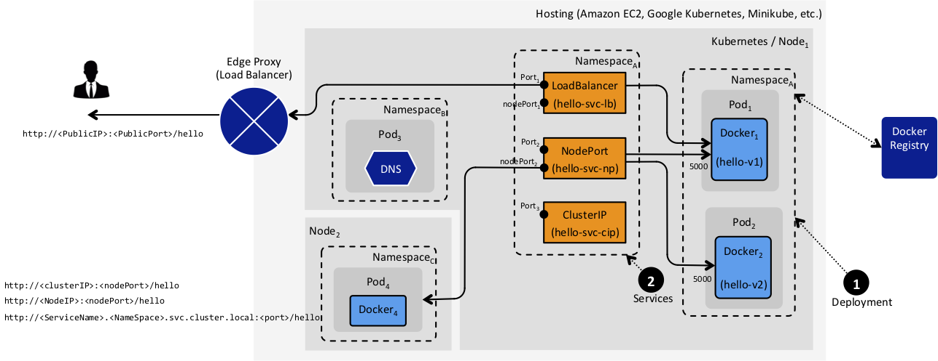
3. Lab 01: Delivering Apps (Pods & Services) (3/3)
?
Any container can hit to other container running in different namespaces.
Too difficult to add security (MTLS, ACL, ..)
I’ve deployed my App (Pods & Services) in Kubernetes.
Now, Will the CI/CD scale?, Is it secure?
Too difficult to add more routes.
Sometimes the Edge Proxy should be managed / reconfigured everytime a new Route is added/changed.

Slide 16
3. Lab 02: Traffic Management – Ingress (1/3)
Hosting (Amazon EC2, Google Kubernetes, Minikube, etc.)
Kubernetes
Node₁
Ingress Controller
Namespace_{A}
Edge Proxy
(Load Balancer)
Ingress Resource₁
Namespace_{A}
LoadBalancer
....
Port₁
LoadBalancer
Namespace_{A}
Ingress Resource_{n}
nodePort₁
(hello-svc-lb)
Pod₁
http://<PublicIP>:<PublicPort>/hello
Docker₁
Docker Registry
Port₂
NodePort
1
nodePort₂
(hello-svc-np)
5000
(hello-v1)
2
Deployment
3
Service
Ingress
Port₃
ClusterIP
Pod₂
(hello-svc-cip)
Docker₂
Namespace_{B}
Pod₃
DNS
Call NodePort or ClusterIP to Pods
5000
(hello-v2)
Ingress Controller
---
apiVersion: v1
kind: Service
metadata:
name: hello-svc-np
labels:
app: hello
namespace: hello
spec:
type: NodePort
ports:
- name: http
port: 5030
targetPort: 5000
selector:
app: hello
---
---
apiVersion: extensions/v1beta1
kind: Ingress
metadata:
name: hello-ing
annotations:
kubernetes.io/ingress.class: istio
spec:
rules:
- http:
paths:
- path: /hello
backend:
serviceName: hello-svc-np
servicePort: 5030
---
1
Deploy the choosen Ingress Controller in Pods and in a specified Namespace. Default HTTP Backend with custom error pages can be implemented.
Configure and integrate the deployed Ingress Controller with the EdgeProxy (Firewall, Root Proxy, Load Balancer, etc.). Generally, Ingress Controller is configured as Kubernetes Service LoadBalancer.
2
3
Finally, during CD time, every API/Microservice will be deployed with Ingress Resource definition (routing). TLS, MTLS or HTTP can be defined.
Notes:
What Ingress Controller can i use?
An Ingress Controller is a Proxy that works as Kubernetes Controller. They manage the traffic between EdgeProxy and Service Mesh (APIs/Microservices).
A Proxy deployed in Pods doesn’t mean that you have an Ingress Controller.
There are several Ingress Controller implementations, they can manage different kind of traffic (HTTP, HTTPS, gRCP, Websockets, TCP, UDP, …) and different functionalities (VIP, Virtual Hosts, Paths, …); then the chosen Ingress Controller depends on the kind of traffic that your API/Microservices manage and how they were implemented (Ports exposed, Paths used, Headers expected, etc.)
Examples:
Heption Contour (based on Envoy Proxy)
Istio Ingress Controller (based on Envoy Proxy)
Linkerd Ingress Controller (based on Linkerd Gateway)
HAProxy Controller (based on HAProxy)
NGINX Controller (based on NGINX), etc.

Slide 17
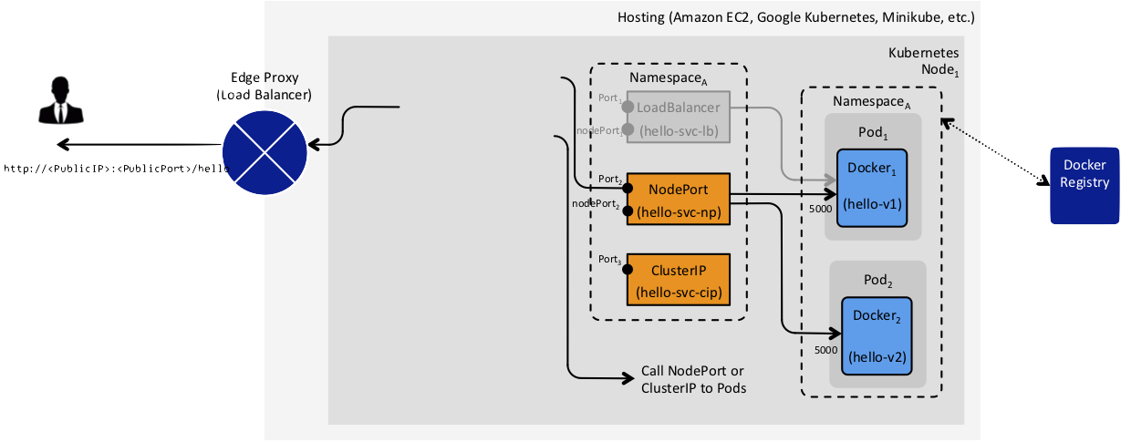
3. Lab 02: Traffic Management – Ingress (2/3)
Ingress Controller
Namespace_{A}
Ingress Resource₁
LoadBalancer
....
Ingress Resource_{n}
1
2
Deployment
3
Service
Ingress
?
It isn’t secure because the Pods still are accesibles. Any other Pod (container) can call this.
I’ve implemented the Ingress Controller in Service Mesh.
Now, Is that Secure?
It isn’t secure because that doesn’t have:
Separation of Duties
Principle of Last Privilege
Identity-based Security
End-to-end security: the App Container still is available and nobody can stop to make call to that Container.
Container Patterns (sidecar container as last-mile protection)
Registry, Auditability and Traceability. It means that all App Containers (APIs and Microservices) living in the Service Mesh should be Identified and Traceable.
Notes:
What Ingress Controller can i use?
An Ingress Controller is a Proxy that works as Kubernetes Controller. They manage the traffic between EdgeProxy and Service Mesh (APIs/Microservices).
A Proxy deployed in Pods doesn’t mean that you have an Ingress Controller.
There are several Ingress Controller implementations, they can manage different kind of traffic (HTTP, HTTPS, gRCP, Websockets, TCP, UDP, …) and different functionalities (VIP, Virtual Hosts, Paths, …); then the chosen Ingress Controller depends on the kind of traffic that your API/Microservices manage and how they were implemented (Ports exposed, Paths used, Headers expected, etc.)
Examples:
Heption Contour (based on Envoy Proxy)
Istio Ingress Controller (based on Envoy Proxy)
Linkerd Ingress Controller (based on Linkerd Gateway)
HAProxy Controller (based on HAProxy)
NGINX Controller (based on NGINX), etc.

Slide 18
3. Lab 02: Traffic Management – Ingress (3/3)
---
apiVersion: extensions/v1beta1
kind: Deployment
metadata:
name: hello-v1
namespace: hello
spec:
replicas: 1
template:
metadata:
labels:
app: hello
version: v1
spec:
serviceAccountName: helloworld-sa
containers:
- name: helloworld
image: istio/examples-helloworld-v1
imagePullPolicy: IfNotPresent
ports:
- containerPort: 5000
---
apiVersion: extensions/v1beta1
kind: Deployment
metadata:
name: hello-v2
namespace: hello
spec:
replicas: 1
template:
metadata:
labels:
app: hello
version: v2
spec:
serviceAccountName: hello-sa
containers:
- name: helloworld
image: istio/examples-helloworld-v2
imagePullPolicy: IfNotPresent
ports:
- containerPort: 5000
---
---
apiVersion: v1
kind: Service
metadata:
name: hello-svc-np
labels:
app: hello
namespace: hello
spec:
type: NodePort
ports:
- name: http
port: 5030
targetPort: 5000
selector:
app: hello
---
---
apiVersion: extensions/v1beta1
kind: Ingress
metadata:
name: hello-ing
annotations:
kubernetes.io/ingress.class: istio
#kubernetes.io/ingress.class: "nginx“
#kubernetes.io/ingress.class: “haproxy“
namespace: hello
spec:
rules:
- http:
paths:
- path: /hello
backend:
serviceName: hello-svc-np
servicePort: 5030
---
## installing Istio Ingress and Pilot (Registry/Discovery)
$ kubectl apply -f install/kubernetes/components/istio-ns.yaml
$ kubectl apply -f install/kubernetes/components/istio-config.yaml
$ kubectl apply -f install/kubernetes/components/istio-pilot.yaml
## before installing Istio Ingress remove configuration about mixer and zipkin (monitoring)
$ kubectl apply -f install/kubernetes/components/istio-ingress.yaml
## deploy HelloWorld App and Ingress Resource definition
$ kubectl apply -f hello-app-with-ingress.yaml
## check that HelloWorld is managed through Istio Ingress
$ kubectl logs -l istio=ingress -n istio-system
...
[...] removing cluster out.hello-svc-np.hello.svc.cluster.local|http
[...] add/update cluster out.hello-svc-np.hello.svc.cluster.local|http
## call the HelloWorld API through Ingress Controller
$ kubectl get svc -l istio=ingress -n istio-system
NAME TYPE CLUSTER-IP EXTERNAL-IP PORT(S) AGE
istio-ingress LoadBalancer 10.110.84.84 <pending> 80:32148/TCP,443:31183/TCP 16m
$ export ING_PORT=$(kubectl get svc istio-ingress -n istio-system -o jsonpath='{.spec.ports[0].nodePort}')
$ curl -s http://$(minikube ip):${ING_PORT}/hello
## exploring Istio Pilot by calling Istio Pilot API
$ minikube ssh -- curl -s ${ISTIO_PILOT_CIP_IP}:${ISTIO_PILOT_CIP_PORT}/v1/registration

Slide 19
3. Lab 03: Traffic Management: Ingress and Sidecar (1/2)
Hosting (Amazon EC2, Google Kubernetes, Minikube, etc.)
Kubernetes Node₁
Namespace_{secure}
Namespace_{A}
Edge Proxy
(Load Balancer)
Ingress Controller
Ingress Resource₁
Namespace_{A}
LoadBalancer
Services
....
LoadBalancer
Pod₁
Ingress Resource_{n}
(hello-svc-lb)
Docker₁
http://<PublicIP>:<PublicPort>/hello
NodePort
Sidecar_{x}
Docker Registry
1
Port₂
(hello-svc-np)
5000
(hello-v1)
Deployment
nodePort₂
7
2
3
ClusterIP
Pod₂
Service
Ingress
(hello-svc-cip)
Docker₂
TLS Pass-through and Termination config.
Sidecar_{y}
AuthN + AuthZ
Service
5000
(hello-v2)
Registry
Call NodePort or ClusterIP to Pods
4
Container Patterns
6
Registry and Discovery
5
“Identity-based Security” strategy
Ingress Controller
End-to-end Authenticated Traffic Management
TLS & Certificates
1
Deploy the choosen Ingress Controller in Pods and in a specified Namespace. Default HTTP Backend with custom error pages can be implemented.
Inject Sidecar in the same Pod where the App Container is living. Sidecar bootstraps security config. in order to reject traffic coming from untrusted source (other App Containers)
The TLS termination should be configured properly in order to be managed dynamically for the Ingress Controller. It means to manage the lifecycle of the TLS Certs.
4
7
Configure and integrate the deployed Ingress Controller with the EdgeProxy (Firewall, Root Proxy, Load Balancer, etc.). Generally, Ingress Controller is configured as Kubernetes Service LoadBalancer.
+
+
2
5
The “Single Source of Truth“ in the Service Mesh does “AuthN & AuthZ” (It validates and authorizes all incomming traffic).
The Sidecar assures End-to-end TLS communication (between API/Microservice and Edge Proxy through Ingress Controller). Additionally, Sidecar manages the TLS Certificate Lifecycle (revocation, renewal, validations, etc.)
4
3
Finally, during CD time, every API/Microservice will be deployed with Ingress Resource definition (routing). TLS, MTLS or HTTP can be defined.
6
It provides a fine-grained control over all App Containers running in the Service Mesh.

Slide 20
3. Lab 03: Traffic Management: Ingress and Sidecar (1/2)
---
apiVersion: extensions/v1beta1
kind: Deployment
metadata:
name: hello-v3
namespace: hello
spec:
replicas: 1
template:
metadata:
labels:
app: hello
version: v3
scenario: e2e
spec:
serviceAccountName: hello-sa
containers:
- name: helloworld
image: istio/examples-helloworld-v1
env:
- name: SERVICE_VERSION
value: "v3"
imagePullPolicy: IfNotPresent
ports:
- containerPort: 5000
---
---
apiVersion: v1
kind: Service
metadata:
name: hello-svc-np-e2e
labels:
app: hello
version: v3
scenario: e2e
namespace: hello
spec:
type: NodePort
ports:
- name: http
port: 5040
targetPort: 5000
selector:
app: hello
version: v3
scenario: e2e
---
---
apiVersion: extensions/v1beta1
kind: Ingress
metadata:
name: hello-ing-e2e
labels:
app: hello
version: v3
scenario: e2e
annotations:
kubernetes.io/ingress.class: istio
namespace: hello
spec:
rules:
- host: v3.helloworld.com
http:
paths:
- path: /hello
backend:
serviceName: hello-svc-np-e2e
servicePort: 5040
---
## deploy the sidecar-injected HelloWorld v3 and new Ingress Resource definition
$ istioctl kube-inject –f hello-v3.yaml –o hello-v3-istio.yaml
$ kubectl apply -f hello-v3-istio.yaml
## call the sidecar-injected HelloWorld v3
$ export ISTIO_INGRESS_PORT=$(kubectl get svc istio-ingress -n istio-system -o jsonpath='{.spec.ports[0].nodePort}')
$ curl -s -H "Host: v3.helloworld.com" http://$(minikube ip):${ISTIO_INGRESS_PORT}/hello

Slide 21
3. Lab 04: Service Mesh - Reference Architecture

Slide 22
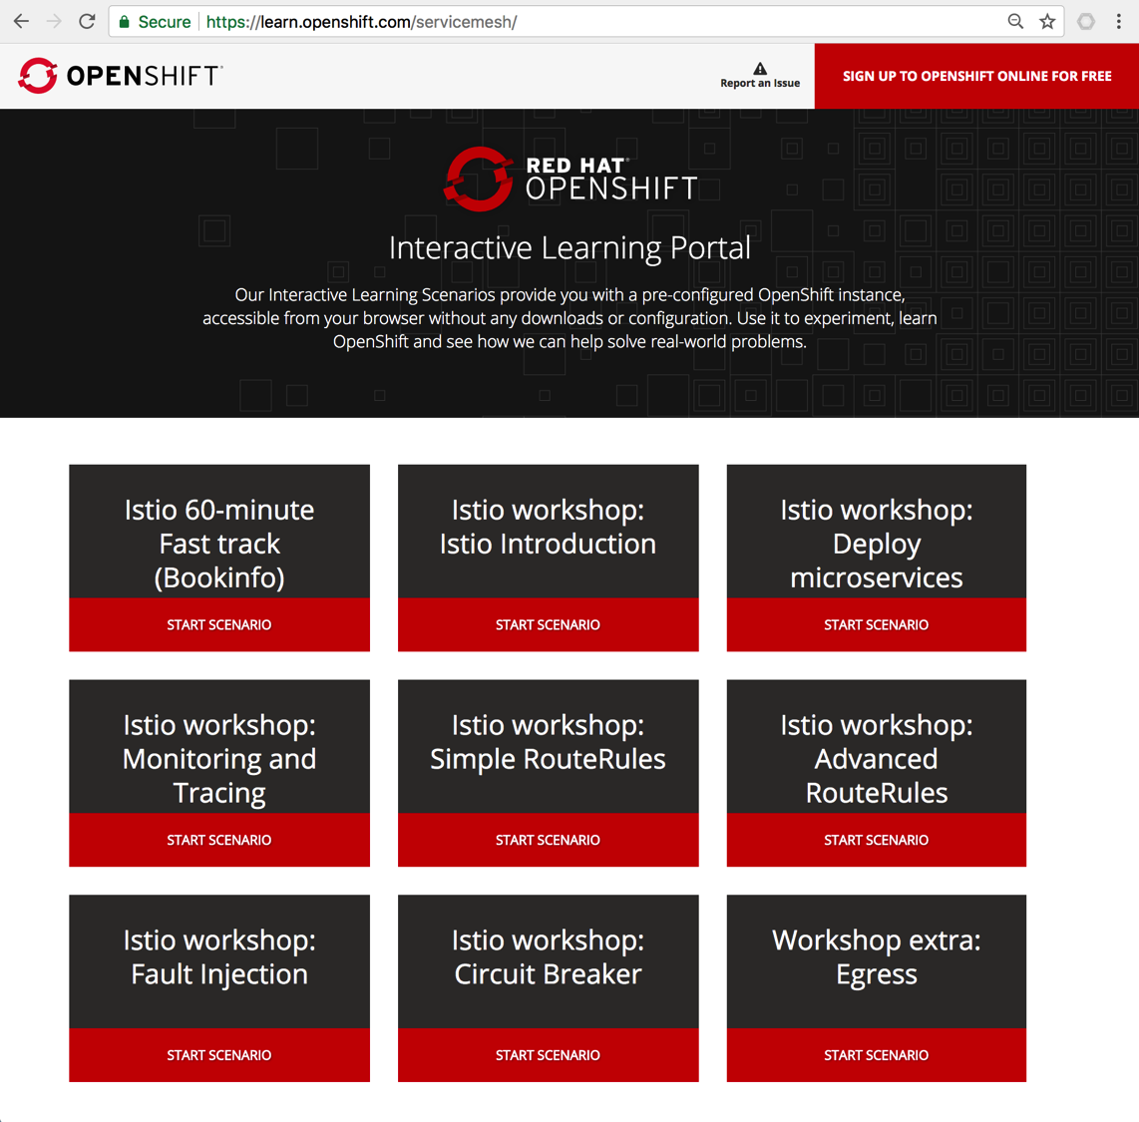
3. Lab 04: Service Mesh – Learning Istio
https://learn.openshift.com/servicemesh

Slide 23


3. Lab 04: Service Mesh – Istio Framework
Hosting
Edge Proxy
(Load Balancer)
Kubernetes
Node₁
Services
ClusterIP₁
Pod₁
Service Mesh Control Plane
Istio Ingress
Docker₁
ClusterIP₂
Sidecar₁
Istio CA
ClusterIP₃
Istio Pilot
Istio Mixer
Kubernetes
Node₂
Istio Auth
Pod₂
Docker₂

Slide 24
3. Lab 04: Istio – E2E Secure Traffic Management
Hosting
Edge Proxy
(Load Balancer)
Kubernetes
Node₁
Services
ClusterIP₁
Pod₁
Service Mesh Control Plane
Istio Ingress
Docker₁
ClusterIP₂
Sidecar₁
Istio CA
ClusterIP₃
Istio Pilot
Istio Mixer
Kubernetes
Node₂
Istio Auth
Pod₂
Docker₂
To implement this, follow this guide:
https://github.com/kelseyhightower/istio-ingress-tutorial

Slide 25
3. Lab 05: Chaining APIs (PoC)
Hosting
Edge Proxy
(Load Balancer)
Kubernetes
Node₁
Services
Pod₁
Pod₂
Docker₁
5
Docker₂
ClusterIP₂
(5001)
(5050)
(test1-svc)
(80)
4
(gis-test-sidecar)
(gis-test-api)
1
ClusterIP₁
(6000)
2
(test1-ambassador- svc)
3
Pod₃
Docker₃
Kubernetes API Server
(gis-validator)

